Slide 1

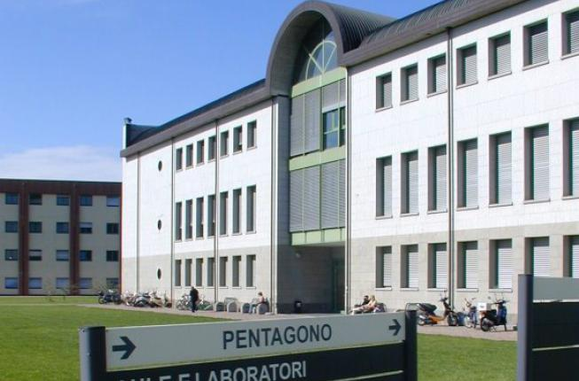


Agripolis Library
OPENING HOURS
Monday – Thursday
8.30 – 18.00
Friday
8.30 – 14.30
FIND US
Pentagono Building- 2nd floor
Agripolis Campus
https://biblio.unipd.it/biblioteche/agripolis
CONTACTS
tel. 049 8272513 biblio.agripolis@unipd.it
biblio.agripolis.unipd

Slide 2

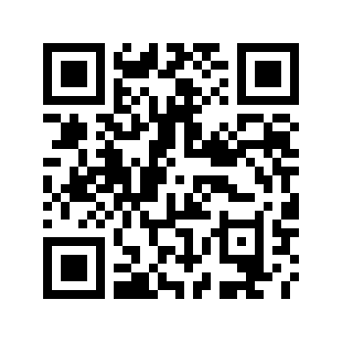
Agripolis Library
Book a seat
At you arrival,
confirm your reservation

Slide 3
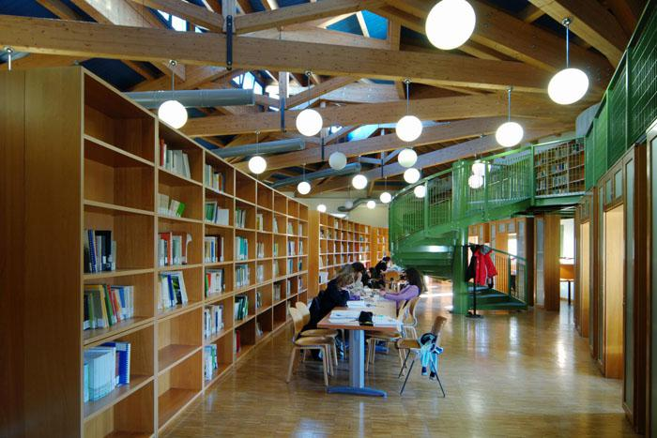
Agripolis Library
In the library you can:
read books, journals and other documents
borrow books
access to online journals, e-books, databases
use PC stations and wifi
photocopy and print documents
attend training courses
use reference service
TEXTBOOKS
You can search them via Galileo Discovery or click in the syllabus in UNIWEB

Slide 4
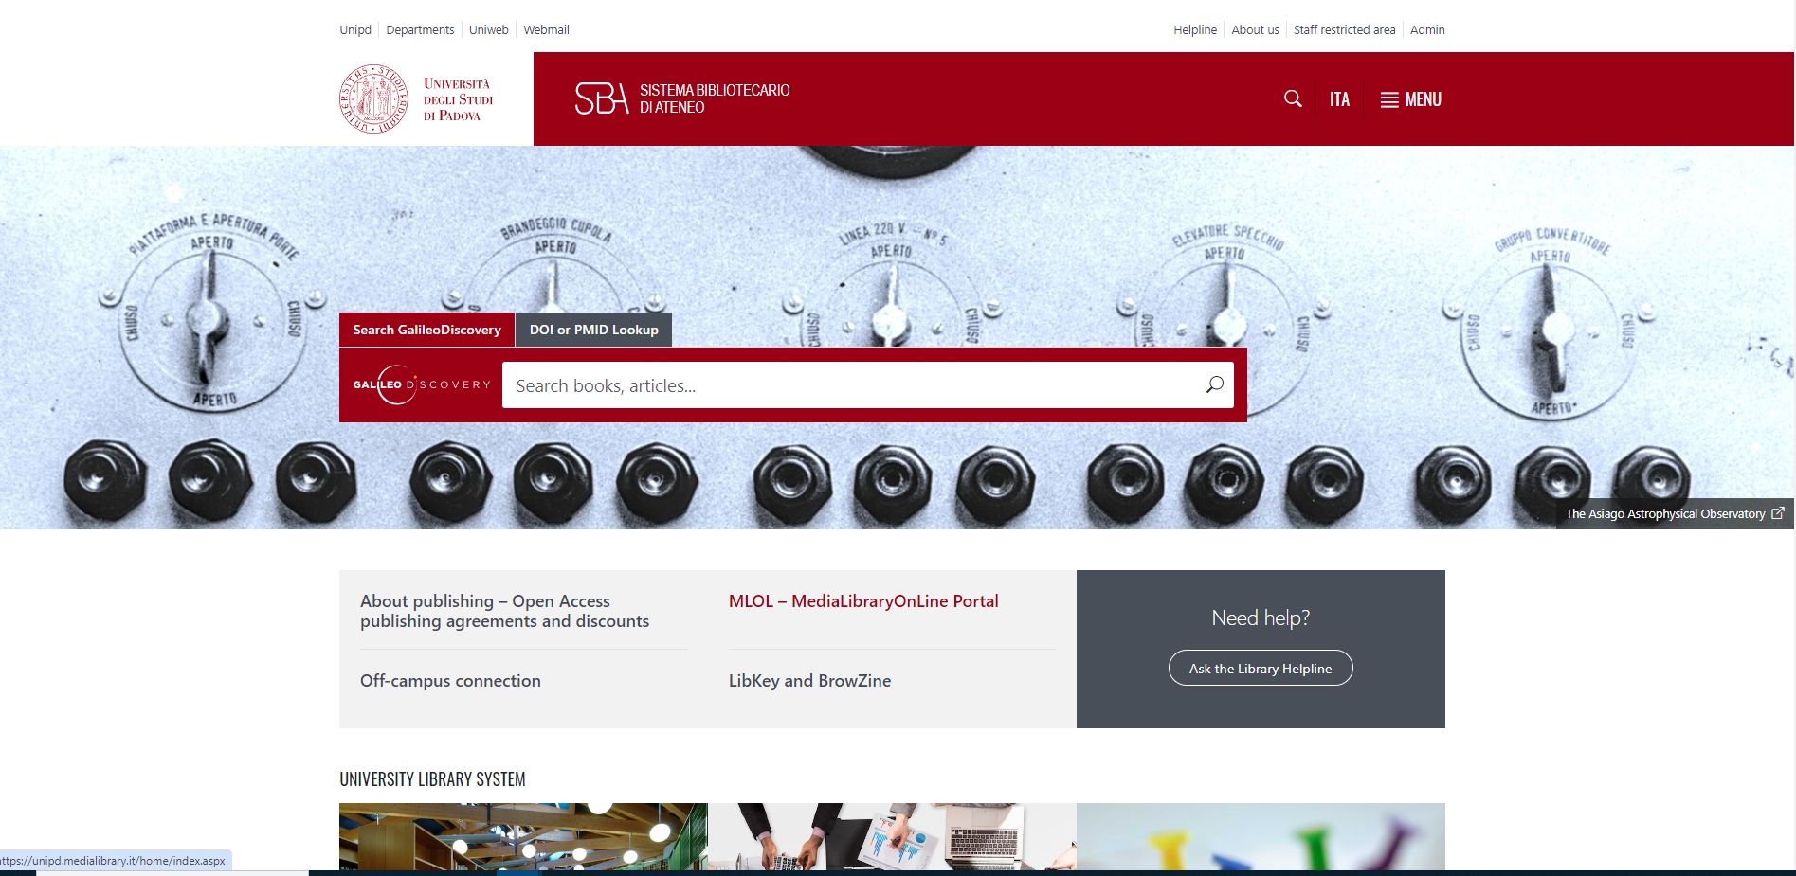



biblio.unipd.it

